Slide 1
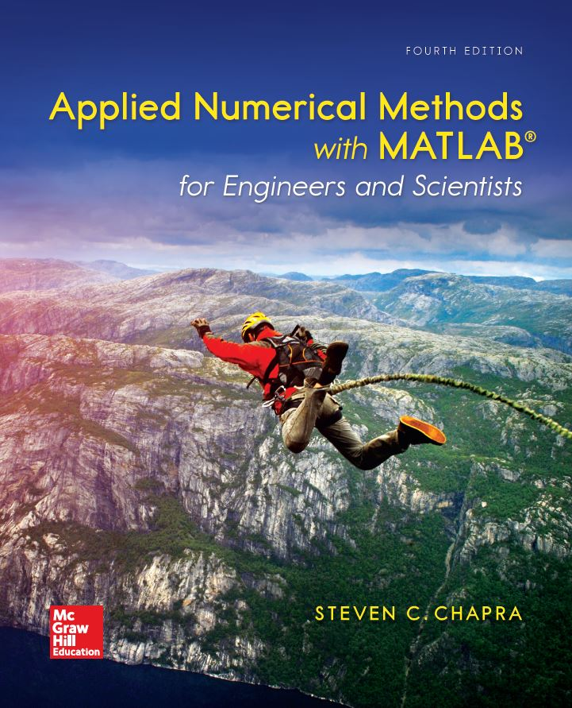
Applied Numerical Methods with MATLAB® for Engineers and Scientists 4th Edition
Steven C. Chapra
PowerPoints organized by Dr. Michael R. Gustafson II, Duke University and Prof. Steve Chapra, Tufts University
©McGraw-Hill Education. All rights reserved. Authorized only for instructor use in the classroom. No reproduction or further distribution permitted without the prior written consent of McGraw-Hill Education.

Slide 2
Part 3 Chapter 12
Iterative Methods

Slide 3
Chapter Objectives
Understanding the difference between the Gauss-Seidel and Jacobi methods.
Knowing how to assess diagonal dominance and knowing what it means.
Recognizing how relaxation can be used to improve convergence of iterative methods.
Understanding how to solve systems of equations the MATLAB fsolve function.

Slide 4
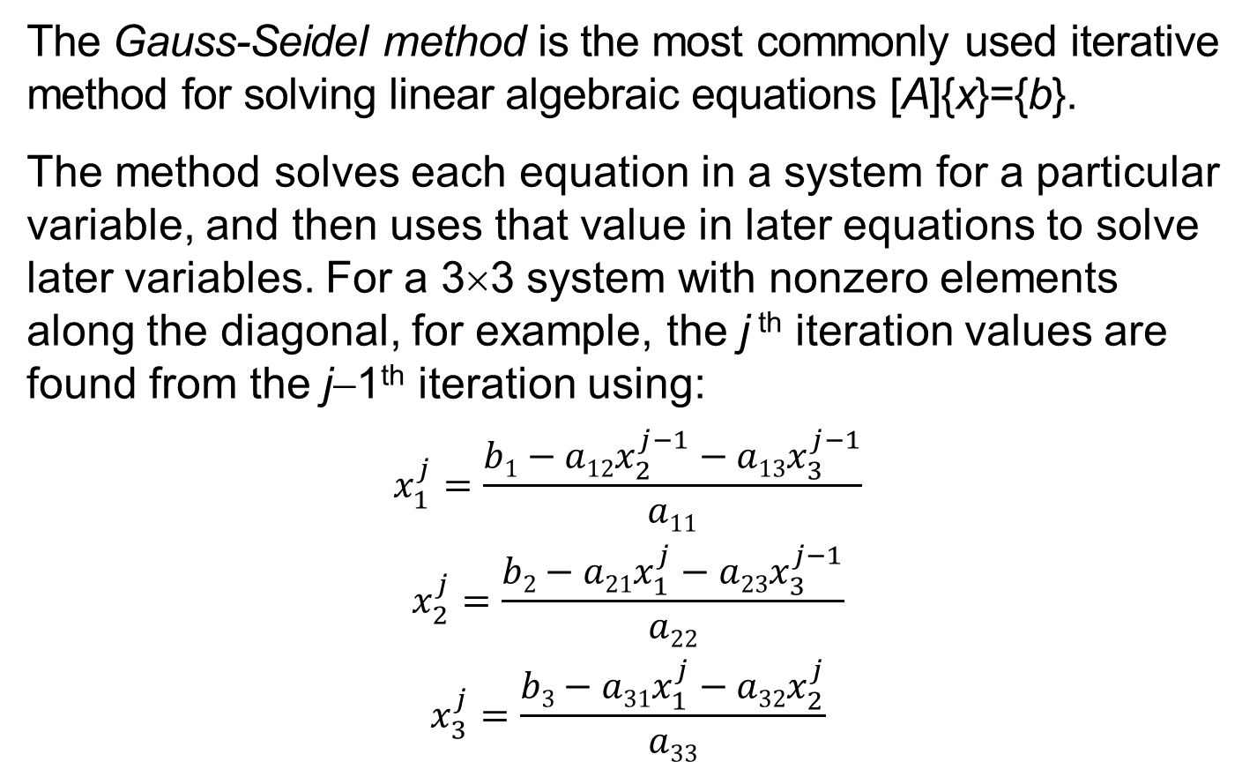
Gauss-Seidel Method
The Gauss-Seidel method is the most commonly used iterative method for solving linear algebraic equations [A]{x}={b}.
The method solves each equation in a system for a particular variable, and then uses that value in later equations to solve later variables. For a 3×3 system with nonzero elements along the diagonal, for example, the j ^{th} iteration values are found from the j−1th iteration using:
$$x_{1}^{j}=\frac{b1−a12x_{2}^{j−1}−a13x_{3}^{j−1}}{a11}$$
$$x_{2}^{j}=\frac{b2−a21x_{1}^{j}−a23x_{3}^{j−1}}{a22}$$
$$x_{3}^{j}=\frac{b3−a31x_{1}^{j}−a32x_{2}^{j}}{a33}$$

Slide 5
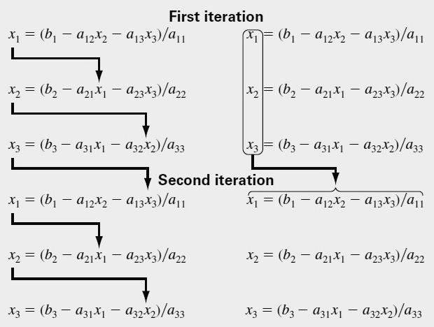
Jacobi Iteration
The Jacobi iteration is similar to the Gauss-Seidel method, except the j−1th information is used to update all variables in the j ^{th} iteration:
Gauss-Seidel
Jacobi

Slide 6
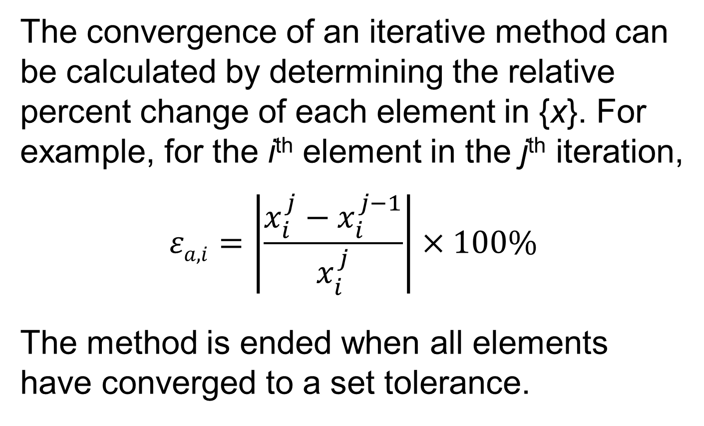
Convergence
The convergence of an iterative method can be calculated by determining the relative percent change of each element in {x}. For example, for the i^{th} element in the j^{th} iteration,
$$εa\text{,}i=\left|\frac{x_{i}^{j}−x_{i}^{j−1}}{x_{i}^{j}}\right|×100\%$$
The method is ended when all elements have converged to a set tolerance.

Slide 7
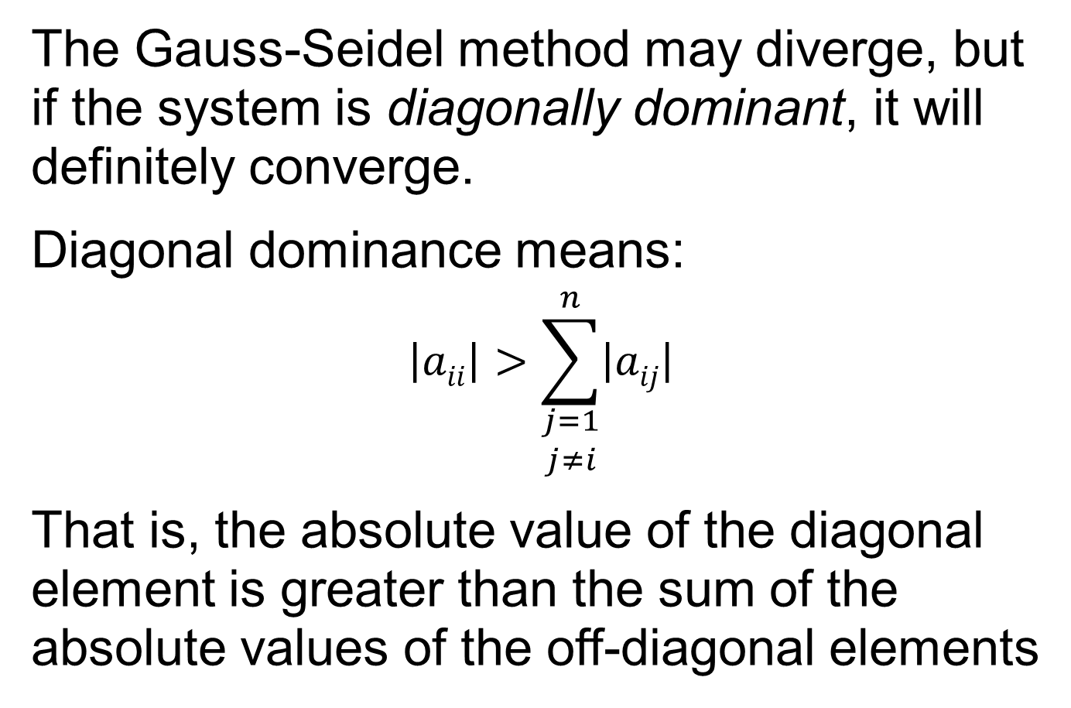
Diagonal Dominance
The Gauss-Seidel method may diverge, but if the system is diagonally dominant, it will definitely converge.
Diagonal dominance means:
$$\left|aii\right|>\sum_{\begin{aligned}j=1 \\ j≠i\end{aligned}}^{n}{\left|aij\right|}$$
That is, the absolute value of the diagonal element is greater than the sum of the absolute values of the off-diagonal elements

Slide 8
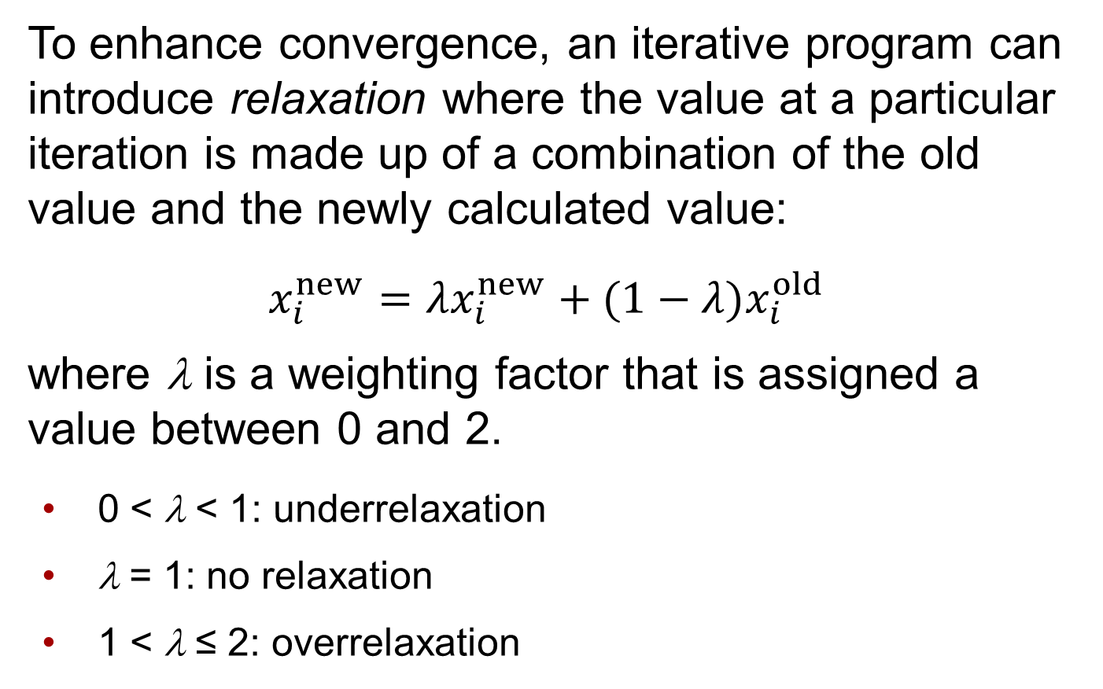
Relaxation
To enhance convergence, an iterative program can introduce relaxation where the value at a particular iteration is made up of a combination of the old value and the newly calculated value:
$$x_{i}^{new}=λx_{i}^{new}+(1−λ)x_{i}^{old}$$ where λ is a weighting factor that is assigned a value between 0 and 2.
0 < λ < 1: underrelaxation
λ = 1: no relaxation
1 < λ ≤ 2: overrelaxation

Slide 9
Nonlinear Systems
Nonlinear systems can also be solved using the same strategy as the Gauss-Seidel method - solve each system for one of the unknowns and update each unknown using information from the previous iteration.
This is called successive substitution.

Slide 10
MATLAB’s fsolve Function
The fsolve function solves systems of nonlinear equations with several variables. Its syntax is
[x, fx] = fsolve(function, x0, options)
where
[x, fx] = a vector containing the roots x and a vector fx
containing the values of the functions evaluated at the roots,
function = the name of the function containing a vector
holding the equations being solved,
x0 = a vector holding the initial guesses for the unknowns, and
options = a data structure created by the optimset function.
Note that if you desire to pass function parameters but not use the options, pass an empty vector [] in its place.

Slide 11
MATLAB’s optimset Function
The optimset function has the syntax
options = optimset('par₁',val₁,'par₂',val₂,...)
where the parameter par_{i} has the value val_{i}.
The parameters commonly used with the fsolve function are
display: When set to 'iter' displays a detailed record of all the iterations.
tolx: A positive scalar that sets a termination tolerance on x.
tolfun: A positive scalar that sets a termination tolerance on fx.
NOTE: A complete listing of all the possible parameters can be obtained by merely entering optimset at the command prompt.

Slide 12
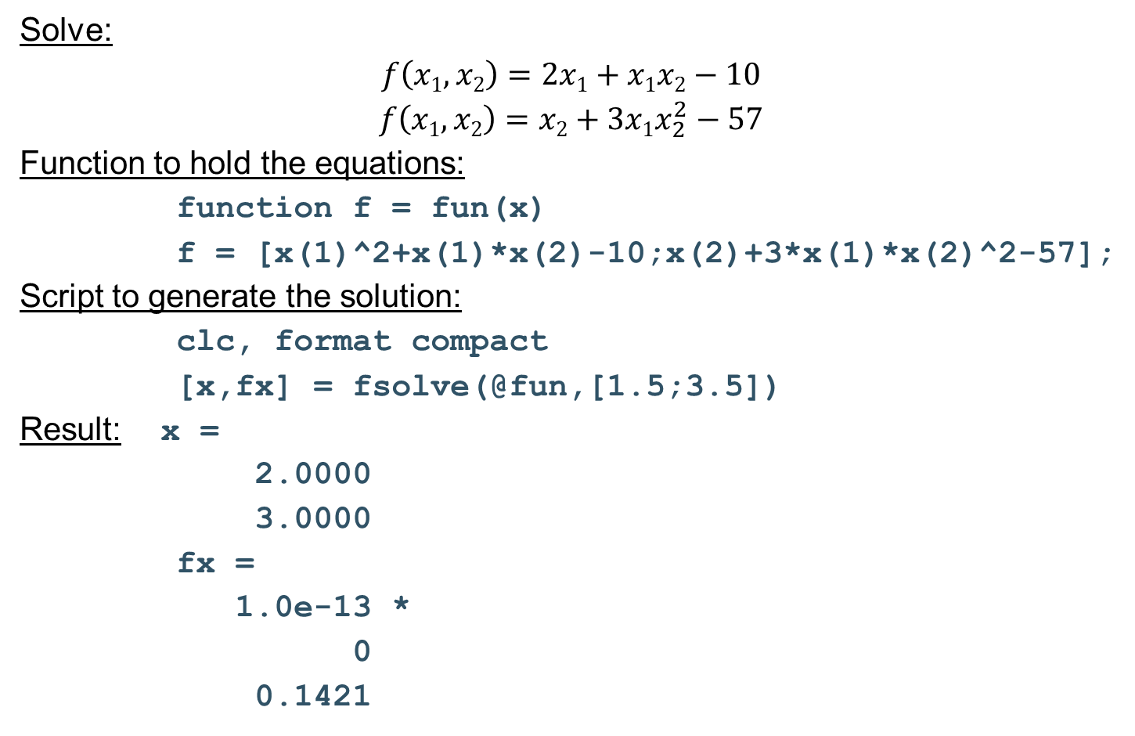
fsolve Example
Solve:
$$f\left(x1,x2\right)=2x1+x1x2−10$$
$$f\left(x1,x2\right)=x2+3x1x_{2}^{2}−57$$
Function to hold the equations:
function f = fun(x)
f = [x(1)^2+x(1)*x(2)-10;x(2)+3*x(1)*x(2)^2-57];
Script to generate the solution:
clc, format compact
[x,fx] = fsolve(@fun,[1.5;3.5])
Result: x =
2.0000
3.0000
fx =
1.0e-13 *
0
0.1421

Slide 13
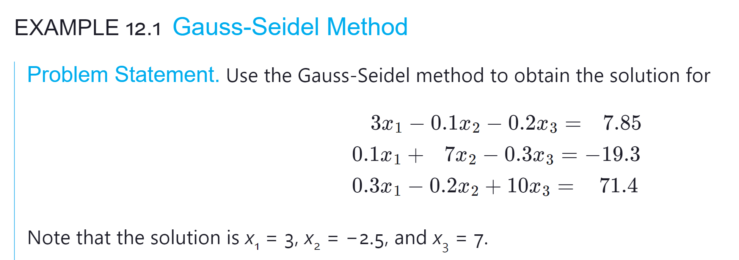

Slide 14
